Slide 1

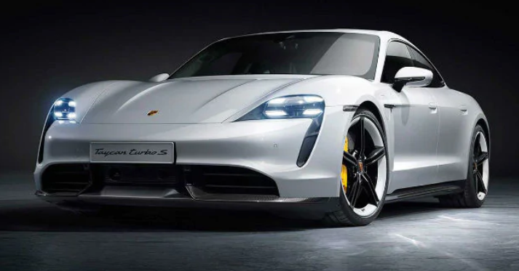
CAR PERFORMANCE PREDICTION
Using Machine learning Algorithm
Developed By:
Kavya Sriram
Madhu Dugyala
Shravani Ambaragonda
Veeranna Kathri

Slide 2

Predicting car performance using linear regression

Slide 3
Introduction
Below is the Brief of our Project:
Car price prediction is somehow interesting and popular problem.
Accurate car performance prediction involves expert knowledge, because performance usually depends on many distinctive features and factors.
Typically, most significant ones are mpg (miles per gallon), horsepower , engine and peak rpm .
Here, we applied different methods and techniques in order to achieve higher performance of the car.

Slide 4
Purpose
The automotive industry is extremely competitive.
With increasing fuel prices and picky consumers, automobile makers are constantly optimizing their processes to increase fuel efficiency.
But, what if you could have a reliable estimator for a car’s mpg given some known specifications about the vehicle? Utilizing machine learning, we can build prediction models designed to give you an edge over your competitors.
After all ,visualization is the best way to understand from multiple machine learning algorithms and withdrawing the conclusions.

Slide 5
Block diagram

Slide 6
Advantages
● Effective predictive model which predicts whether car mpg is “High” or “Low”.
● Easy and simple User Interface for the customer’s who is going to evaluate the performance of the car.
● Linear Regression is simple to implement and easy to interprete the output of the coefficient.
● Linear Regression gives the accurate result of the prediction up to 95% which is the algorithm we used for prediction.
● It can work in real time and predicted as soon as the necessary details for prediction are given to the model.

Slide 7
Dis-Advantages
●The model should be highly predictive in nature i.e it should show 80% of accuracy.
●The model should give high accuracy when tested it on the test dataset.
● One of the biggest drawback is using gasoline –powered cars in the amount of pollution into the atmosphere .
● On the other hand in the linear regression technique outliers can have huge effects on the regression and boundaries are linear in this technique.
● Car performance prediction can be a challenging task due to the high number of attributes that should be considered for the accurate prediction.

Slide 8
Conclusion
●During this model, we built a model that could reliably predict a car’s mpg given some information about the car within 27 mpg of the actual value. this model could be trained with car data and be used to predict competitor’s future mpg ratings for upcoming cars.
●while our model may be inaccurate in some cases, we talked about how our dataset can contain inaccurate values for the mpg, and oftentimes, our predictions are more accurate
than the values in the dataset.
● For cars, the collected data is significantly more reliable, so our model will be able to perform better with a different, more accurate dataset.

Slide 9

THANK YOU

